Slide 1
MACHINE LEARNING
PROJECT
AIR QUALITY PREDICTION USING MACHINE LEARNING TECHNIQUES
Submitted To :-
Prof. Bharti Rana
Submitted By :-
Divya Solanki
Vandana Yadav

Slide 2
Background and Problem Definition
The issue of pollution in urban cities is a major problem these days especially in cities like the New Delhi is detected with more number of toxic gases in air, which has reduced the air quality of New Delhi.
Thus, predictive analytics play a significant role in predicting the future instances of air quality based on the historical data.
Forecasting the air quality of the city is mandatory to overcome its consequences. Strategies for air quality management can be developed.
Several machines learning algorithm is widely used these days to predict the future instances. Such as random forest, support vector machine, regression, classification, and so on.
Here we have focused mainly on data set of New Delhi for predicting ambient air pollution and quality using several machines learning algorithm.

Slide 3
Problem Domain
Air is mixture of gases around earth and performs a vital role in supporting life on Earth.
But with the passage of time the fresh and pure air is gradually getting contaminated due to increase in air pollution.
Air pollution is the presence of one or more substance at a concentration above their natural levels, with the potential to produce an adverse effect on environment.
According to World Population Review, Delhi, the National Capital Territory (NCT) of India, is the densely populated metropolitan city with a large influx of population from other states of India. As per the last Census carried out in 2011, population of Delhi was 16.7 million [2]
In recent years, rapid industrialization and urbanization posed detrimental effect on environment. Problem of air pollution is increasingly getting more serious.
Increasing levels of pollutants in air is causing extreme health disorder. It directly affects a population of millions who are suffering from shortness of breath, eye irritation to chronic respiratory disorders, pneumonia, acute asthma etc
The main and most dangerous component of these pollutants particles are PM2.5 particles, as the name itself suggests. Atmospheric particles (PM) less than 2.5 μm, about 3% of the diameter of a human hair. Concentrations of PM2.5 it is measured in μg/m3.[3]

Slide 4
Causes Of Air Pollution
There can be many cases for Air Pollution , some of them are.
Industrial exhaust Emission, harmful gases such as SO2 and NOx from thermal power plants of Rajghat, Badarpur, Indraprastha and other industrial regions adds to the major pollutants of the Delhi air pollution.
Vehicular emission Traffic congestion and vehicular emission contributes majorly to degrading the Delhi air quality. The data accessed from the transport department of Delhi government up to 31-Dec 2016 puts the total number of registered vehicles to 1, 01,06,791. The largest number of the registered vehicles in the city are motor cycles and scooters , numbering 63,40,136 . These are considered to be major contributors towards air pollution [2].
Landfill Burning Recent incidents of Landfill burning in summers have even worsen the AQI of Delhi
Agricultural stubble burning in Punjab and Haryana .Farmers of Punjab and Haryana burning their rice crop stubble to quickly prepare their field for rabi crop wheat [5].
Construction and demolition Continuous construction and demolition contributing to increased level of dust-borne particulate matters in the air and are, therefore, considered hazardous [6].
Factors that may indirectly involve in worsening air quality are over -population, road dust, garbage burning etc.

Slide 5
MAJOR Pollutants
The major concentration of pollutants in the Delhi air is:-
Particulate Matter, RSPM and SPM (PM2.5 and PM10)
Nitrogen Oxide (NOx) industrial combustion processes and primarily as vehicular exhaust.
Sulphur Dioxide (SO2): It is formed mostly by burning of fossil fuels particularly from thermal power plant.
Benzene: The main sources of benzene are from vehicle exhaust and other industrial processes since it is an industrial solvent.
Ozone (O3): Formed by chemical reaction of volatile organic compounds and nitrogen dioxide in the presence of sunlight, so level of ozone is generally higher in the summer.
Toluene: Toluene is another industrial volatile solvent whose short term exposure causes irritation of eyes and the respiratory tract.
Carbon Monoxide (CO)

Slide 6
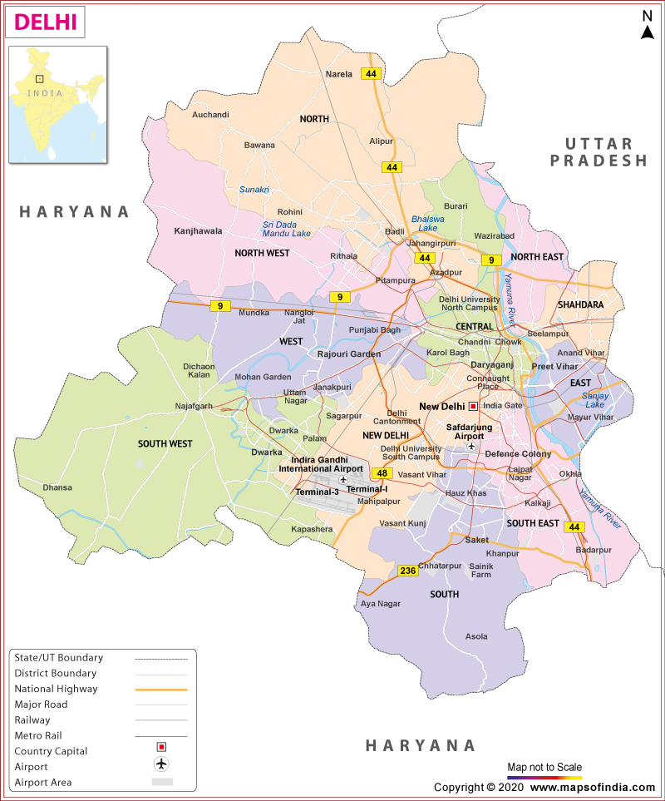
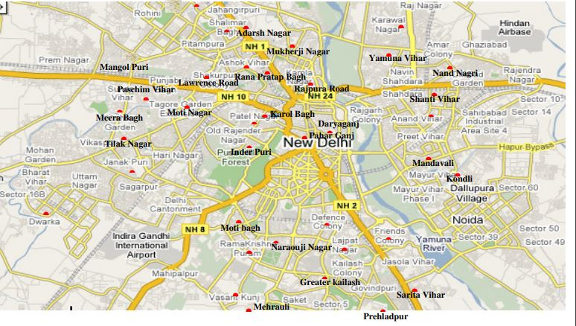
Geographical Area Of Study
Delhi has been considered for the study whose geographical regions are shown in figure 1.
There are 40 air monitoring stations at present in Delhi located at different locations.[4]
Taken from https://www.dpcc.delhigovt.nic.in
Taken from: https://www.mapsofindia.com/maps/delhi/

Slide 7
Paper [1] Air pollution prediction with machine learning: a case study of Indian cities[1] (Springer)
In the mentioned paper, air pollution data of 23 Indian cities for a tenure of six years are investigated. The dataset is cleaned and preprocessed first by filling NAN values, addressing outliers, and normalizing data values.
Then correlation-based feature selection technique is exercised to filter AQI affecting pollutants for further study and logarithmic transformations are applied to the skewed features.
The exploratory data analysis methods are exercised to find various hidden patterns present in the dataset. It was found that almost all pollutants exhibited a significant fall in 2020.
The data imbalance problem is addressed by the SMOTE analysis.
The dataset is split into train-test subsets by the ratio of 75–25% respectively.
ML-based AQI prediction is carried out with and without SMOTE resampling technique and a comparative analysis is presented. The results of ML models for both the train-test subsets are presented in terms of standard metrics like accuracy, precision, recall, and F1-Score.
[1] Air pollution prediction with machine learning: a case study of Indian cities | SpringerLink

Slide 8
Contd.
For both the train-test sets, the XGBoost model attained the highest accuracy and the SVM model exhibited the lowest accuracy.
The classical statistical error metrics, namely MAE, RMSE, RMSLE, and R2 are then evaluated to assess and compare the performances of ML models.
The XGBoost model comes out to be the overall best performer by attaining the optimum values in both training and testing phases.
For the training phase, the RF model performed relatively good when exercised with SMOTE.
On the other hand, almost all ML models exhibited improvements in the testing phase. In this phase, the GNB model attained the best results for R2 in target predictions.
The present research endeavors to contribute to the literature by addressing air quality analysis and prediction for India which might have not been properly studied. This work can be extended by employing deep learning techniques for AQI prediction

Slide 9
Paper [2] A model for particulate matter (PM2.5) prediction for Delhi based on machine learning approaches.
In the mentioned paper, a couple of machine learning techniques, namely the ANN and SVM have been used to predict PM2.5 concentrations in Delhi. Two different models i.e. SVM and ANN, were built on the inputs of various meteorological and pollutant parameters corresponding to a 2-year period from 2016-18.
To avoid any bias with a particular missing value in the dataset that may affect the forecasting model results, a linear interpolation technique has been applied.
SVM was implemented with a linear kernel, with kernel scale value of 1 and a Sequential Minimal optimization as the solver.
They applied a Feed Forward single hidden layer neural network (FFNN) to predict the PM2.5 concentrations, which was trained using the Resilient back propagation algorithm.
The dataset is split into train-test subsets by the ratio of 80–20% respectively.
[2] https://www.sciencedirect.com/science/article/pii/S1877050920307249

Slide 10
Contd.
The accuracy of the ANN model was evaluated by performing a regression analysis between the resulted output and the test data. In the training stage, the simulated PM2.5 values and the target data showed the best fit with a high correlation coefficient (R).
The MSE (mean square error) was used as a statistical measures to analyze the prediction accuracy of the ANN model.
In case of ANN model, it was found that the predicted values were very close to the actual test set target values, suggesting the fact that ANN based model was very much efficient in performing this prediction for most of the data points.
However, the SVM based model was not that much efficient in the task of PM2.5 prediction as it was found that its predicted values were not in close ranges to the actual target test set values. Also, for some data points, the SVM based model aberrated significantly from the target data points, which eventually led to a decline in its test MSE performance.
It was observed that the ANN-based PM2.5 prediction model involving the air pollution and meteorological data exhibited better performance for the available test dataset.

Slide 11
Contd.
The results indicated that ANN has merit in the prediction of PM2.5 concentrations and is able to outperform other machine learning approach used in this study.
The results also indicated that, with improvements in model topography, data quality and computational power, the prediction accuracy of the ANN model can further be fine-tuned for practical application.
Hence it may be concluded that the ANN model with better generalization capabilities may be considered as an optimal candidate technique, for model development, for multi-dimensional complex problems like air pollution.

Slide 12
References
[1] Air pollution prediction with machine learning: a case study of Indian cities | SpringerLink
[2] https://www.sciencedirect.com/science/article/pii/S1877050920307249
[3] Statistical Abstract (2016) Delhi Govt Portal, www.delhi.gov.in.
[4] WHO’s Urban Ambient Air Pollution data base Update 2016 http://www.who.int/phe/health_topics/outdoorair/databases/AAP_database_summary_results_2016_v02.pdf.
[5] https://www.dpcc.delhigovt.nic.in/locationmap#gsc.tab=0

